Slide 1

Welcome to new membership orientation

Slide 2
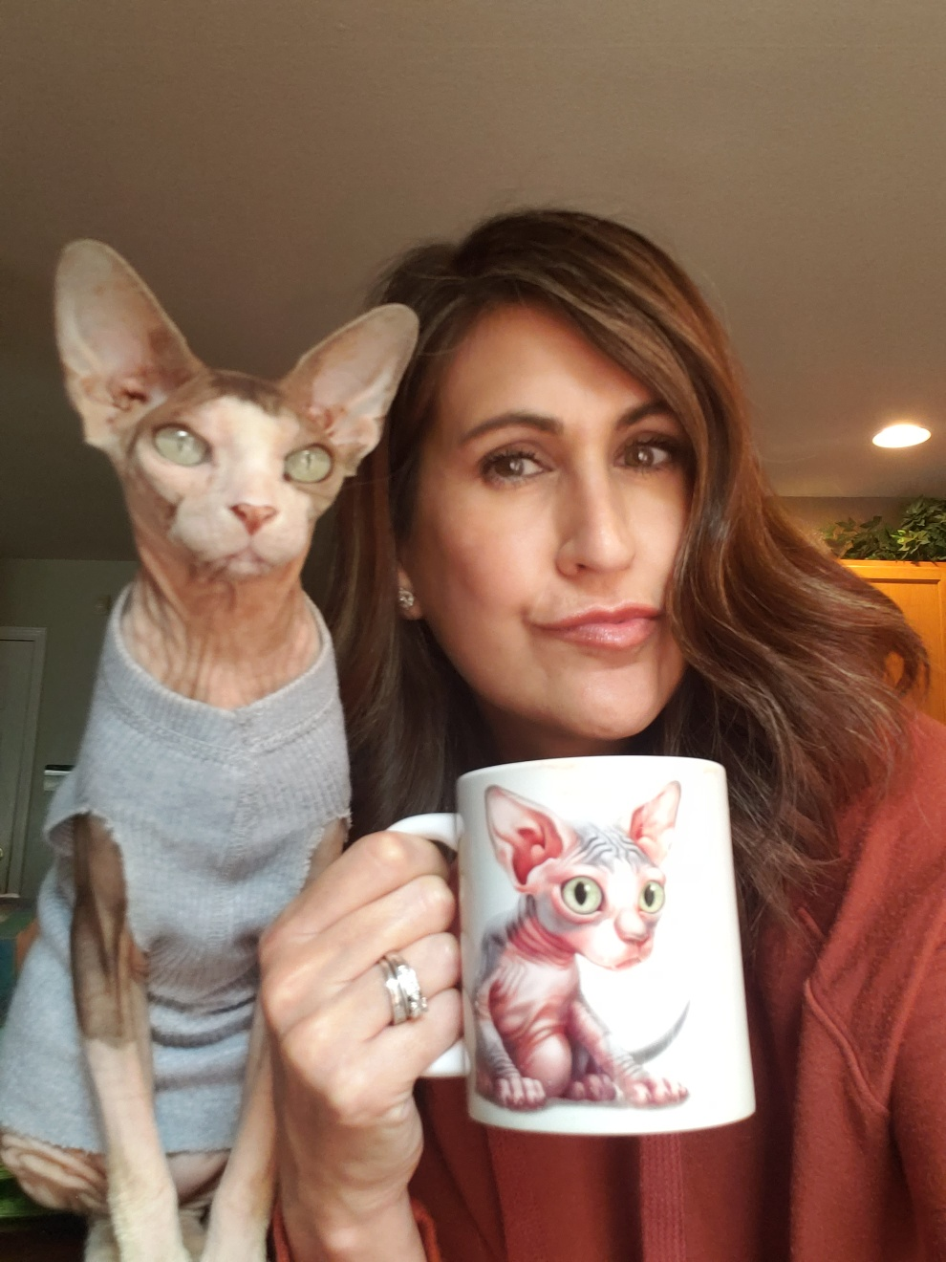
Introductions with Pat Fernandez, 2021 President of four rivers association of realtors®
What is your name and what brokerage are you with?
How long have you been licensed and what is going to be your field of specialty? Residential, Commercial, Property Management or Farm and Ranch.
What was your profession or field of specialty before real estate?

Slide 3
What is a Board of REALTORS® ?
3-tiered organization, each governed by a member elected Board of Directors:
  NAR (founded in 1908)
  TAR (chartered in1920)
  Pre-merger existence (Chartered in the 1960’s) Local Association formed January 1, 2014

Slide 4

The board of directors is the governing body and establishes the policy directives of an organization.
In general, the board of directors has full authority over the internal affairs and manages the assets of an organization.
All members are bound by the governing documents of all three associations.
Governing Documents:
Bylaws
Policies and Procedures of the Associations

Slide 5

Education

Slide 6
Casey Lee – Government Affairs Director
casey@fourriversrealtors.com
512-738-7053
GA Oversight Chair
Melissa Walls
melissa@cornerpostrealestate.com
TREPAC Chair
Brenda Damron
brenda@thedamrongroup.com
Hays County
San Marcos:
Cody Lantelme
cody@carsonproperties.net
Kyle/Buda:
Peggy Jones
peggyjones@austinsa.com
Guadalupe County
Seguin
Ken Kiel
kkiel@cbharper.com
TREPAC Trustee
Debbie Homeier
debbie@vallonerealestate.net
Gonzales County
?
Political Involvement Comittee
Warren Hoskinson
hoskinsonrealestate@yahoo.com
Comal County
New Braunfels/Canyon Lake
Esther Boarnet
eboarnet@gmail.com
Caldwell County
?

Slide 7
Advocacy is more than just political
Under all is the land. Upon its wise utilization and widely allocated ownership depend the survival and growth of free institutions and of our civilization. REALTORS® should recognize that the interests of the nation and its citizens require the highest and best use of the land and the widest distribution of land ownership. They require the creation of adequate housing, the building of functioning cities, the development of productive industries and farms, and the
preservation of a healthful environment.
Such interests impose obligations beyond those of ordinary commerce. They impose grave social responsibility and a patriotic duty to which REALTORS® should dedicate themselves, and for which they should be diligent in preparing themselves. REALTORS®, therefore, are zealous to maintain and improve the standards of their calling and share with their fellow REALTORS® a common responsibility for its integrity and honor.
In recognition and appreciation of their obligations to clients, customers, the public, and each other, REALTORS® continuously strive to become and remain informed on issues affecting real estate and, as knowledgeable professionals, they willingly share the fruit of their experience and study with others. They identify and take steps, through enforcement of this Code of Ethics and by assisting appropriate regulatory bodies, to eliminate practices which may damage the public or which might discredit or bring dishonor to the real estate profession.

Slide 8
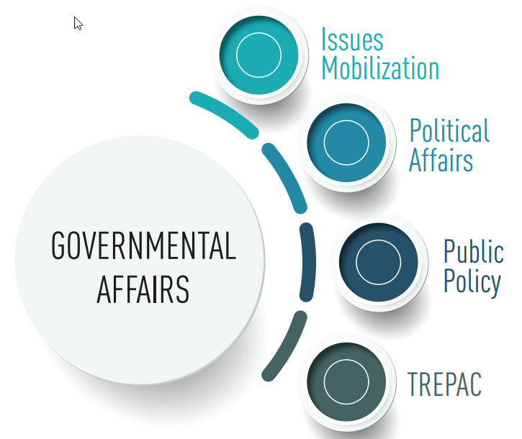
But it is political
Federal - NAR
State – Texas REALTORS®
Local – GA/TREPAC
Committees

Slide 9
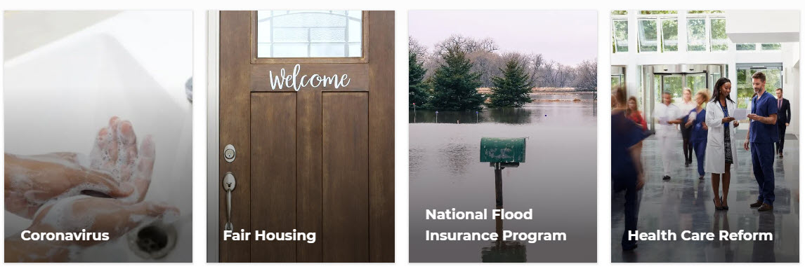

The National Association of REALTORS® advocates daily for 1.4 million REALTORS® and 75 million property owners.
NAR is one of the most effective advocacy organizations in the country.

Slide 10
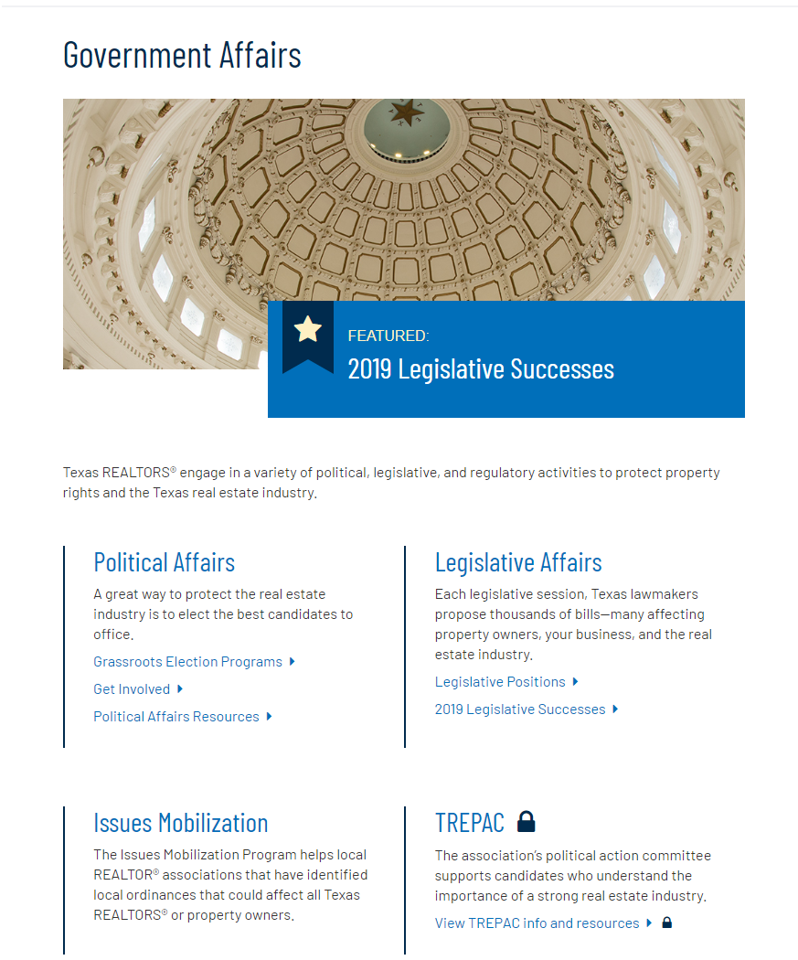


Slide 11
Coming Soon!
Dates of interest for the 87th Texas Legislature
November 9, 2020: Bill prefiling already started
January 12, 2021: 87th Legislature convenes at noon
March 12, 2021: 60-day bill filing deadline
May 31, 2021: Adjournment sine die (a.k.a. last day of session)
June 20, 2021: Post-session 20-day deadline for Governor to sign bills into law or veto bills
August 30, 2021: Effective date for new laws, unless specific date is given

Slide 12

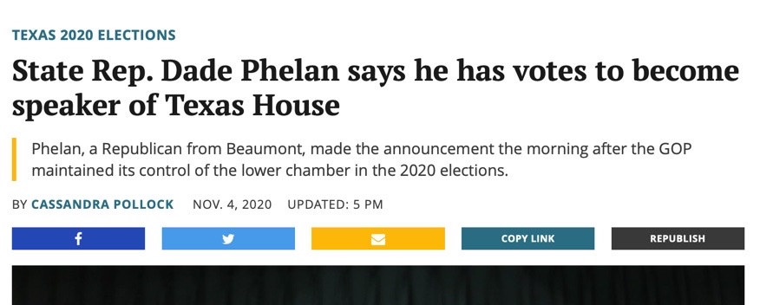
Who Will Be In Charge?
First things first: Elect a new Speaker of the House
Possibly one reason why no special sessions have been called during the pandemic.
Representative Dade Phelan is the presumptive Speaker but won’t be official until Opening Day vote.

Slide 13
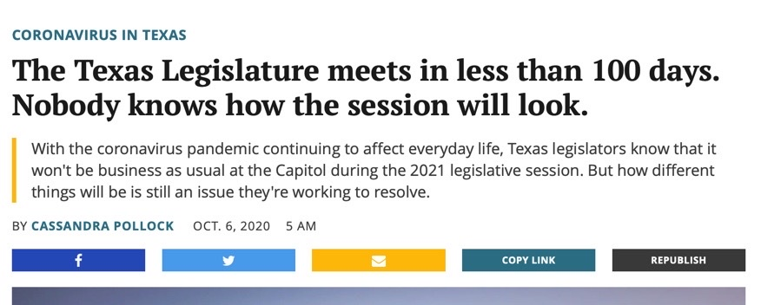
Same Legislature...but, Not the Same!
After all the money spent and drama of the campaign season, there was little to no change in the makeup of the House and Senate.
Key to success will be existing relationships due to limited access
How will adopted rules under pandemic allow for public input?

Slide 14
Run the numbers
Texas REALTORS® reads every single bill!
For example, in 2019 …
16 reviewers
7,851 bills and resolutions filed
2,784 tracked for potential impact on real estate
Over 1,211 Bills filed for 2021, as of last week.

Slide 15

But They Only Have to Pass One
The Texas Legislature is
constitutionally required to pass the state’s two-year budget.
Significant shortfall due to pandemic and oil revenue.
Translation: The state has much less money than expected.

Slide 16

Likely Big Issues
COVID-19/Healthcare Response
Pandemic Action Plan
State vs. Local Rule-making
Election Administration
Redistricting
texasrealestate.com/issues

Slide 17
Everything starts and ends locally
The Four Rivers Assoc. covers five counties and is impacted by every municipality within those counties.
Public Policy: Member driven process to determine a policy idea’s impact on the real estate industry and our stance. Real estate is one of the most regulated industries. Strong public policy ensures consumers can buy, sell, and lease real property without undue burden from the government.
Issues Mobilization: Special fund to help local associations with local policy issues. REALTOR® engagement through Issues Mobilization has been proven to flip public, and elected official, perception on issues, resulting in victories which had seemed impossible. SMTX 4 All
Political Affairs: Core part of GA goals and strategy. Four main goals
1. Keep Texas REALTORS® informed and engaged
2. Build and strengthen relationships with elected officials and candidates
3. Elect REALTOR® Champions at all levels
4. Ensure everyone knows REALTORS® are engaged and paying attention

Slide 18
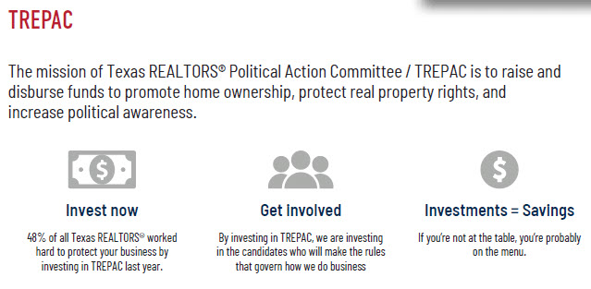

Slide 19
If real estate is your profession, politics is your business. And no one protects the real estate industry and your bottom line like TREPAC/Texas Association of REALTORS® Political Action Committee.
TREPAC backs local, state, and national candidates and elected officials who have a proven track record of protecting private-property rights, preserving the dream of homeownership, and supporting the vitality of the real estate industry.

Slide 20
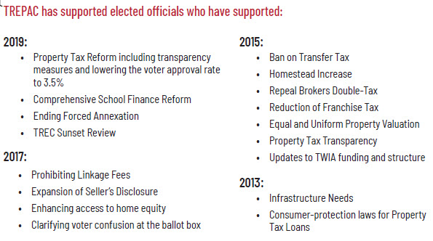

Slide 21
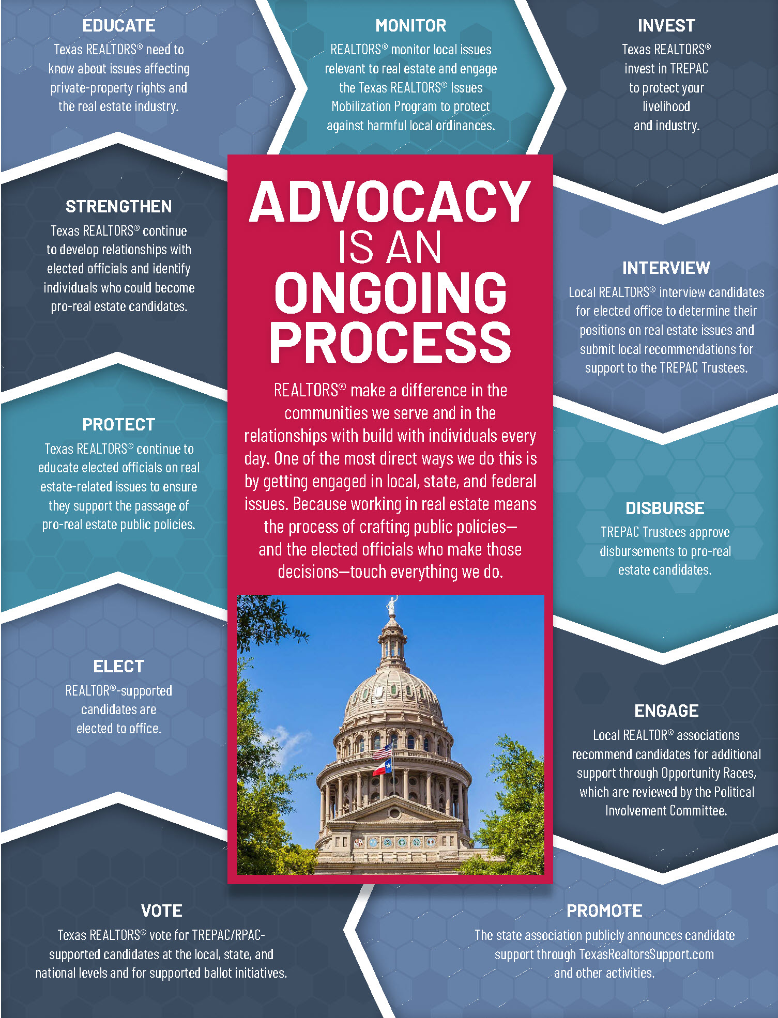


Slide 22
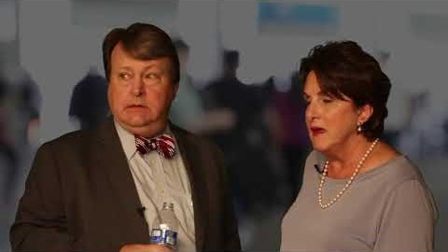
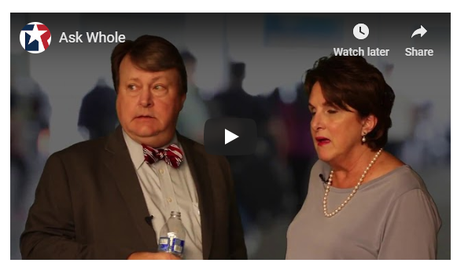

Slide 23

Stay informed
Text “txrealtors” 30644
TexasRealEstate.com/Liaison
TexasRealEstate.com/Issues
Receive periodic updates on issues
important to you and your profession from the experts!

Slide 24
Casey Lee – Government Affairs Director
casey@fourriversrealtors.com
512-738-7053
GA Oversight Chair
Melissa Walls
melissa@cornerpostrealestate.com
TREPAC Chair
Brenda Damron
brenda@thedamrongroup.com
Hays County
San Marcos:
Cody Lantelme
cody@carsonproperties.net
Kyle/Buda:
Peggy Jones
peggyjones@austinsa.com
Guadalupe County
Seguin
Ken Kiel
kkiel@cbharper.com
TREPAC Trustee
Debbie Homeier
debbie@vallonerealestate.net
Gonzales County
?
Political Involvement Comittee
Warren Hoskinson
hoskinsonrealestate@yahoo.com
Comal County
New Braunfels/Canyon Lake
Esther Boarnet
eboarnet@gmail.com
Caldwell County
?

Slide 25

Break time
10 Minutes

Slide 26
ANTITRUST
Federal and state antitrust laws are designed to protect competition, and the opportunity of competitors to engage in business free of artificial restrictions on competition.
Such restrictions include:
Price fixing agreements
Group boycotts
“Tying” arrangements
Market allocation arrangements.

Slide 27

Antitrust

Slide 28

Fair Housing

Slide 29
Fair housing is more than a list of dos and don’ts, rights and penalties, and mandatory continuing education.
As stewards of the right to own, use and transfer private property, fair housing protects our livelihood and business as REALTORS® and depends on a free, open market that embraces equal opportunity.

Slide 30

REALTORS® recognize the significance of the Fair Housing Act and reconfirm their commitment to upholding Fair Housing Law as well as their commitment to offering Equal Professional Service to all in their search for real property.

Slide 31


Slide 32
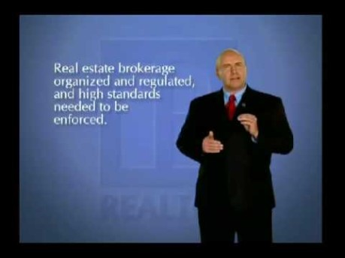
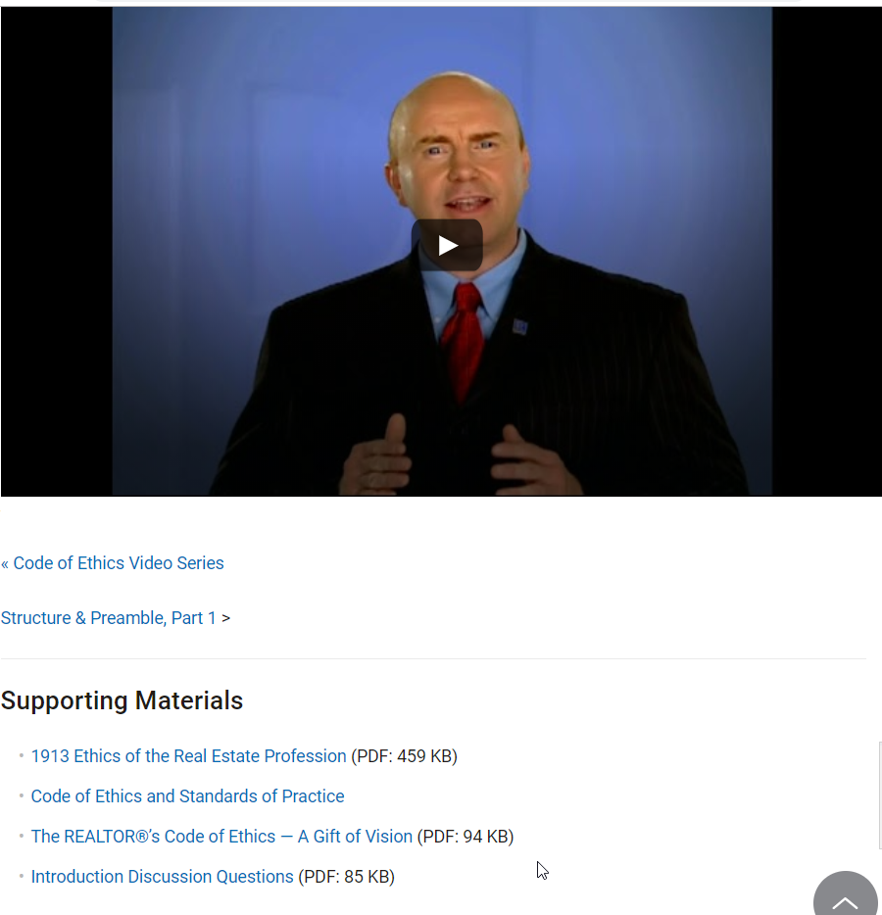

Slide 33
There are fifteen short video segments covering the Preamble, Articles, and Standards of Practice. Included are support material and questions to stimulate discussion. Each segment is five to seven minutes long, available 24/7, and free of charge.

Slide 34
Ethics Complaints
REALTORS® abide by the strict standards of the Code of Ethics. If a REALTOR® has failed to meet these standards, you can file a complaint. First, you must determine if the person is a REALTOR®and, thus, bound by the Code of Ethics. Then you have the following options to resolve your dispute:

Slide 35
Contact the Broker
Contact the person's broker to inform him or her what happened. It could lead to a quick resolution.
Use the Ombudsman Program
A volunteer from the Texas REALTORS® Professional Standards Committee will listen to your concerns, explain possible resolutions, and answer questions.
File an Ethics Complaint
If contacting the broker and talking to an ombudsman don't resolve the problem, you can file a formal complaint.
File an Anonymous Complaint
For certain types of Code of Ethics violations, you can submit an anonymous complaint.
Arbitration
This process is used when you think you're owed money based on an agreement.

Slide 36
NAR Code of Ethics Training Requirement.
Failure to complete training during any cycle will lead to suspension of membership for the January and February immediately following the cycle deadline, with termination of membership starting March 1 after the cycle deadline.
Current Cycle
January 1, 2019 to December 31, 2021
Future Cycles
January 1, 2022 to December 31, 2024
January 1, 2025 to December 31, 2027

Slide 37
The Code of Ethics is your pathway to professionalism. Make sure you understand what separates you, as a REALTOR®, from other real estate professionals, and get your office talking about and living by the Code.

Slide 38
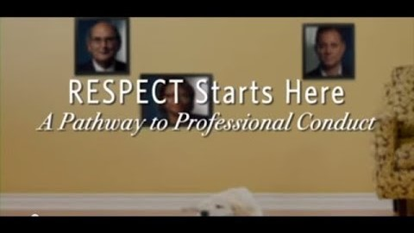

Slide 39
Three ways to make REALTOR® Trademark
REALTOR® should ALWAYS be CAPITALIZED, and trademark used when possible.
*Exception on some social media (Facebook Events and some publications)
Open parenthesis, letter R, closed parenthesis. (R)
ALT 0174
Special Characters in phone/mobile device

Slide 40
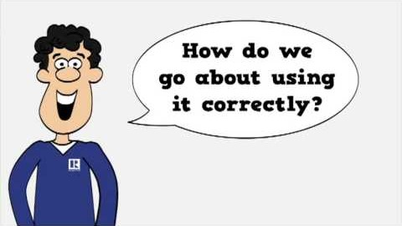
Why NAR Protects the REALTOR® Trademark

Slide 41
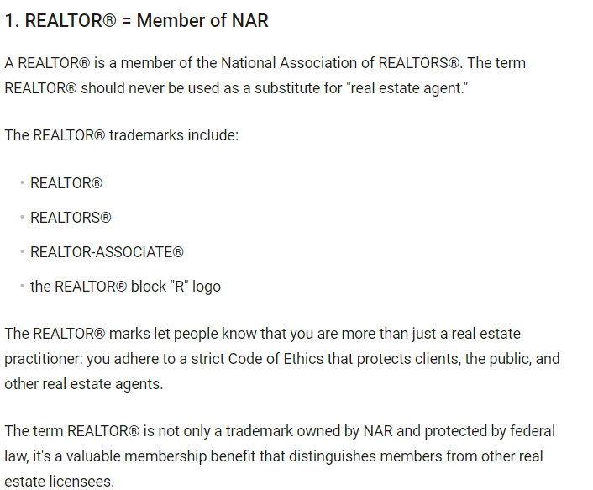

Slide 42
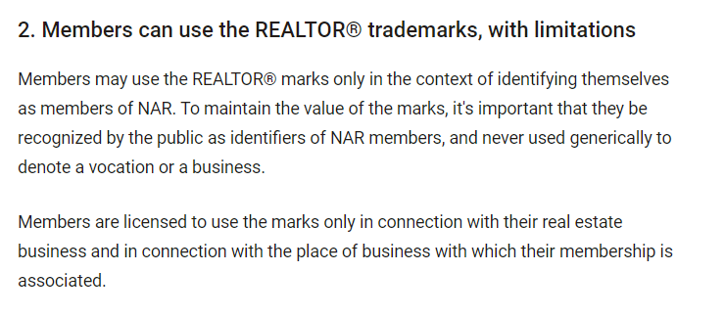

Slide 43
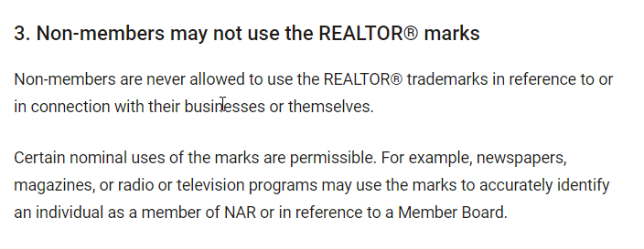

Slide 44
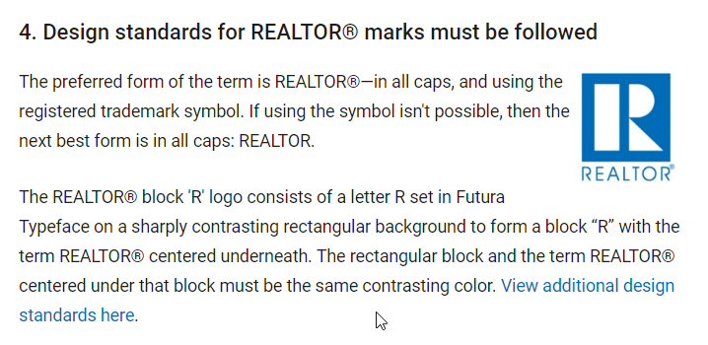

Slide 45
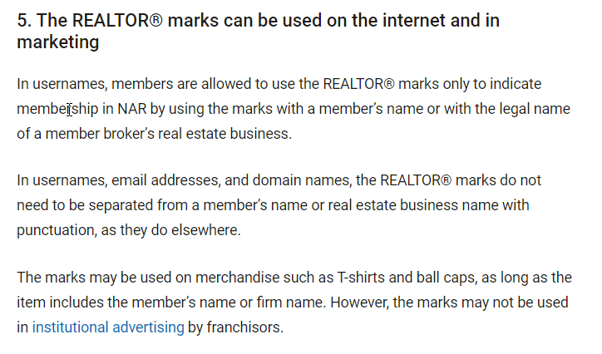

Slide 46

REALTOR® SAFTEY

Slide 47
Lunch
30 Minutes

Slide 48

Marketing & Communications

Slide 49

Communicate with frar
StaY up to date with what is going on
in your association, And in your
real estate profession!

Slide 50
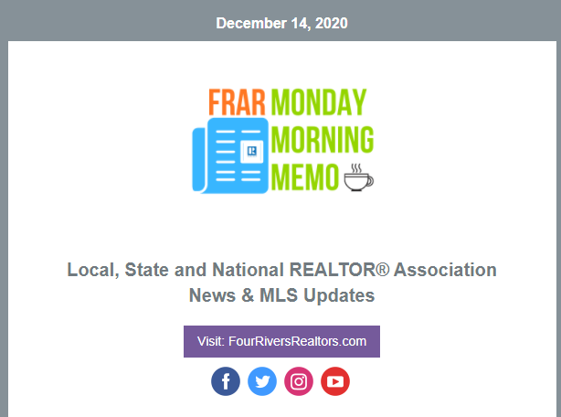
FRAR Weekly Newsletter
Monday morning memo

Slide 51
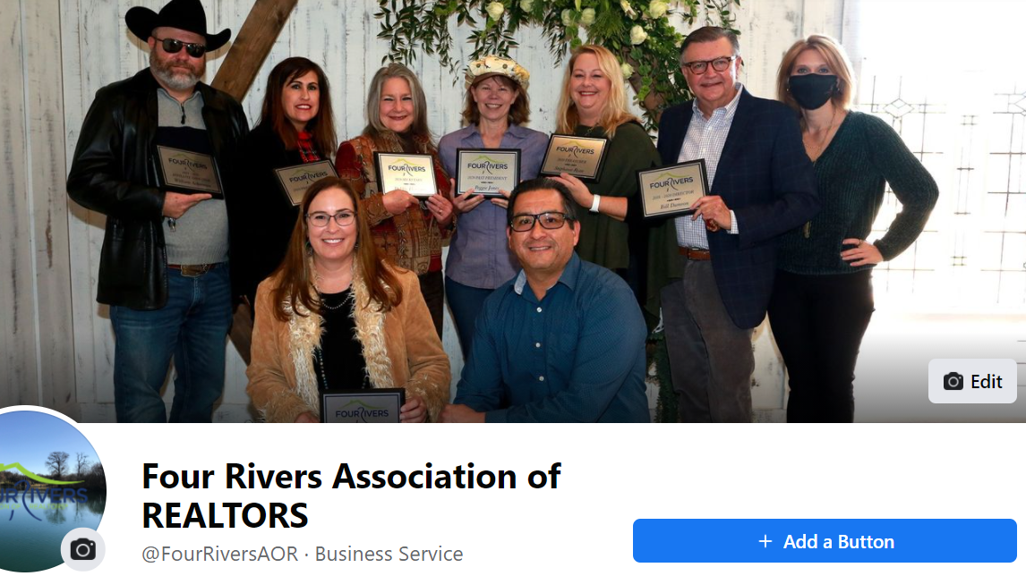
FRAR Facebook: @facebook.com/fourriversaor

Slide 52
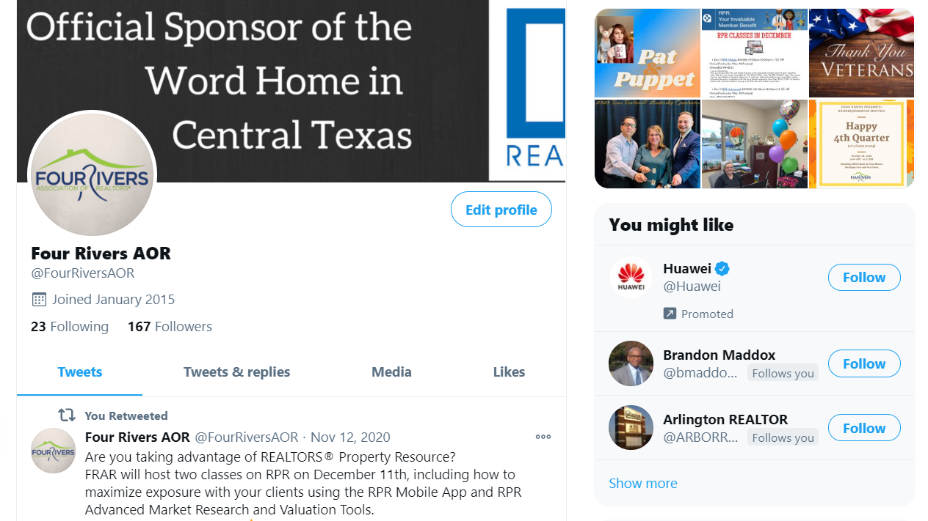
FRAR Twitter: twitter.com/fourriversaor

Slide 53
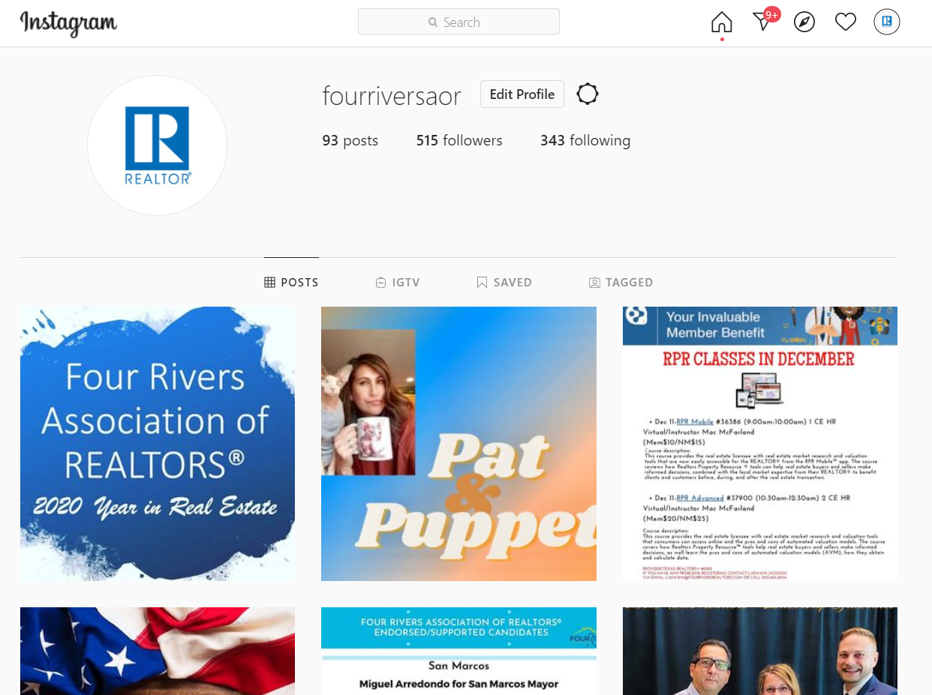
FRAR Instagram:
Instagram.com/fourriversaor

Slide 54
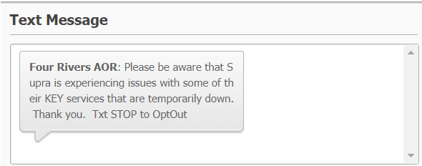
FRAR Texting Program
Toll free #:
1-844-336-3727
*Save to contacts
Text “FRAR" to:
1-844-336-3727 to Opt-In/Message
Important Alerts/Reminders
2-Way Connection

Slide 55
local member benefits
Member Loyalty Cards (Get Punched)
-Quarterly $100.00 drawing
-Annual Dues Drawing
Education Opportunities-
-18 Hrs. of Free Classes Annually
-Up to a 25% Discount on paid classes/Board Store Items
FRAR REALTOR® Kid Scholarship
Exclusive Supra eKey Reciprocity
2 Office Locations
$10 Luncheons/FREE Events
Leadership and Community Outreach

Slide 56
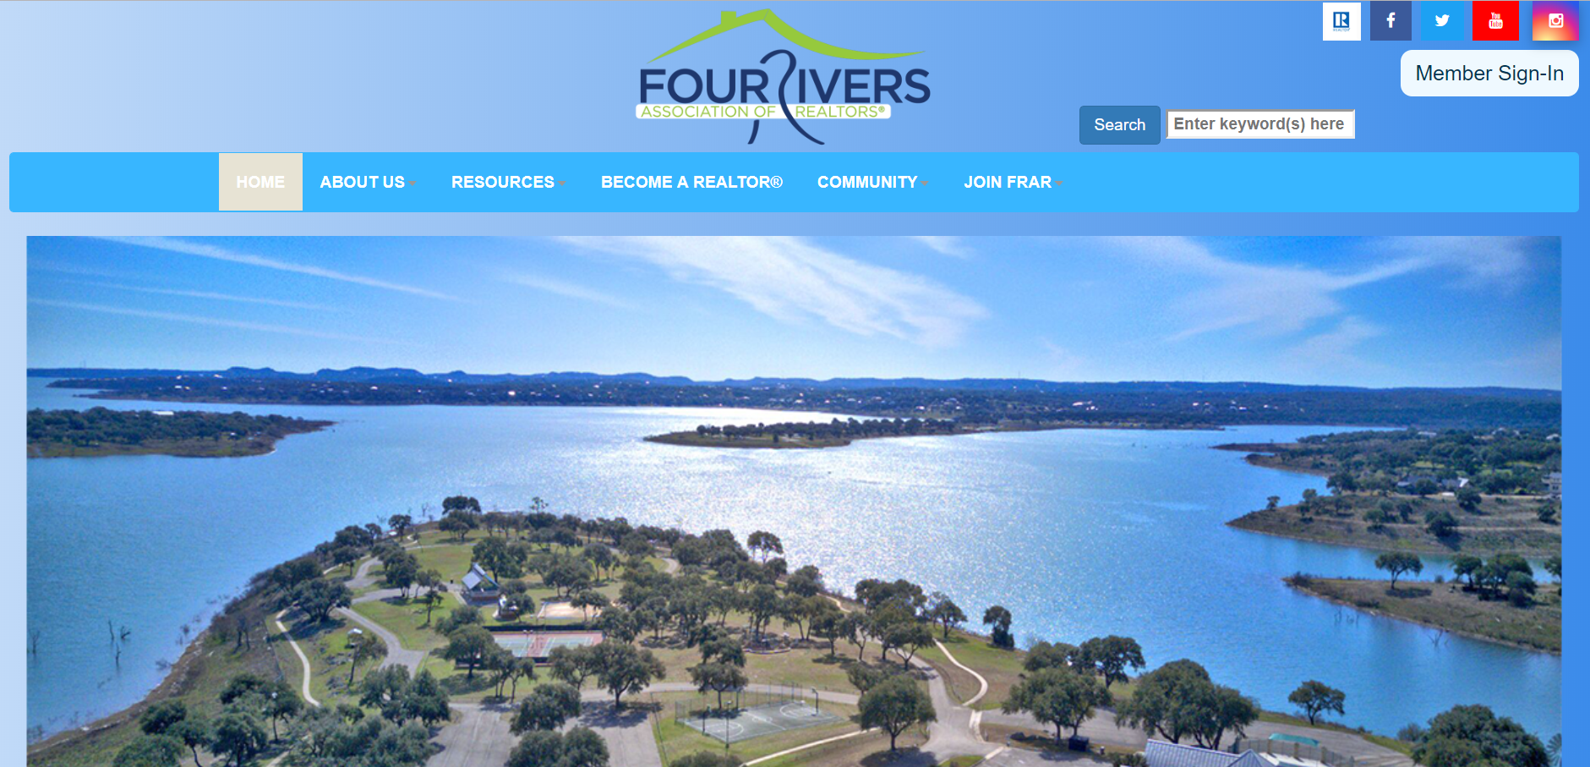
FRAR Website www.fourriversrealtors.com

Slide 57

FRAR Committee Descriptions:

Slide 58
Governmental Affairs: Reviews proposed regulations/rules within local governing bodies, reporting on emerging issues to members. Stays actively involved in all local and political races.
New Braunfels Sub-Committee, San Marcos Sub-Committee, Seguin Sub-Committee
Scholarship: Responsible for the fundraising of designated scholarships given to graduating high school students and includes selection process for recipients and presentations of scholarships to students.
Professional Development: Coordinates/plans membership luncheons and important events (Market Forecast and REALTOR® Rally) to bring relevant content and knowledge to membership.
TREPAC: Political fundraising for the Texas Real Estate Political Action Committee in order to support/endorse local and state candidates.
FRAR MLS: Works to inform and education MLS Subscribers about how to use Matrix and CTXMLS Rules
& Regulations.
Professional Standards: Focus on education and training of The Code of Ethics and Standards of Practice with an emphasis on Broker engagement. Must complete Texas REALTORS® Professional Standards Training.
NextGen: Built on aiding new member, 5 Years and Younger to the Real Estate Profession, through Lunch’n Learns, CE Classes, Panel discussions and community outreach projects. All REALTOR® Members welcome!

Slide 59
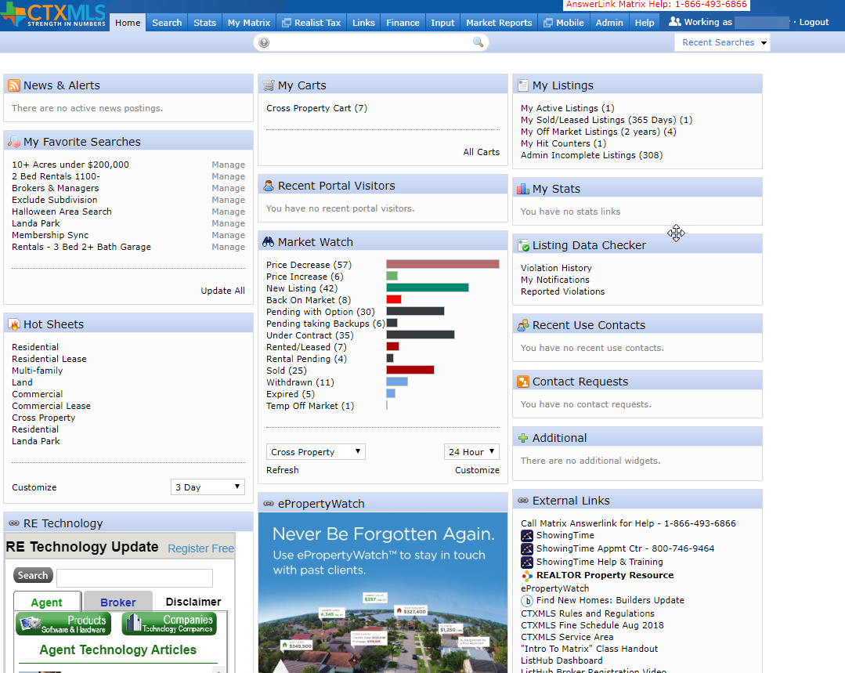

Intro to Matrix
Selena Medina

Slide 60
Break time
5 Minutes

Slide 61

Central Texas Multiple Listing Service

Slide 62
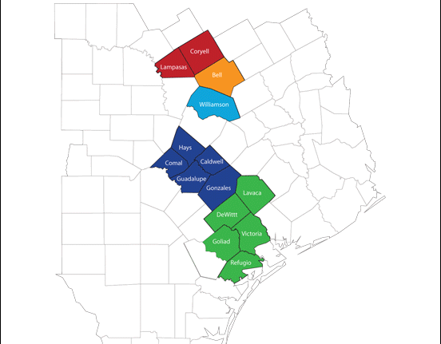
Coverage Area:
-Four Rivers
-Victoria
-Williamson County
-Temple Belton
-Ft Hood
Notes:
Central Texas MLS consists of 5 shareholders.
Four Rivers, Victoria, Williamson County, Temple Belton, and Fort Hood
Together, we currently have 4800+ members and growing

Slide 63
Top Compliance Issues:
Branded or Copied Photos
Addresses not mapped accurately
Wrong Status – Listing says expired when it has sold
Incorrect Information in Remarks – No Gate Codes or contact info
Incorrect Acreage – Split Parcels
Notes:
Branded Photos – You cannot use photos that have logos or contact information in them. You MUST use original pictures and not copied form another agent or MLS.
Address Not Mapped- With many new subdivisions many properties are not found when entered into the MLS. Verify your listing is displayed accurately on the map. If not click “Get Lat/Long Manually” and manually place the map pin where the home or property is located.
Wrong Status – This happens when the listing is entered into multiple MLS and not updated in each. The property is Sold, agent is happy and neglects to update it in the MLS and so it expires.
Incorrect Remarks – Do not put gate codes. This is a security risk for the owners or tenants. Also never put any agent contact information into the remarks
Incorrect Acreage – Happens when owner wants to sell parcels of the total lot. Email Compliance@ctxmls.com and it will be waived.

Slide 64
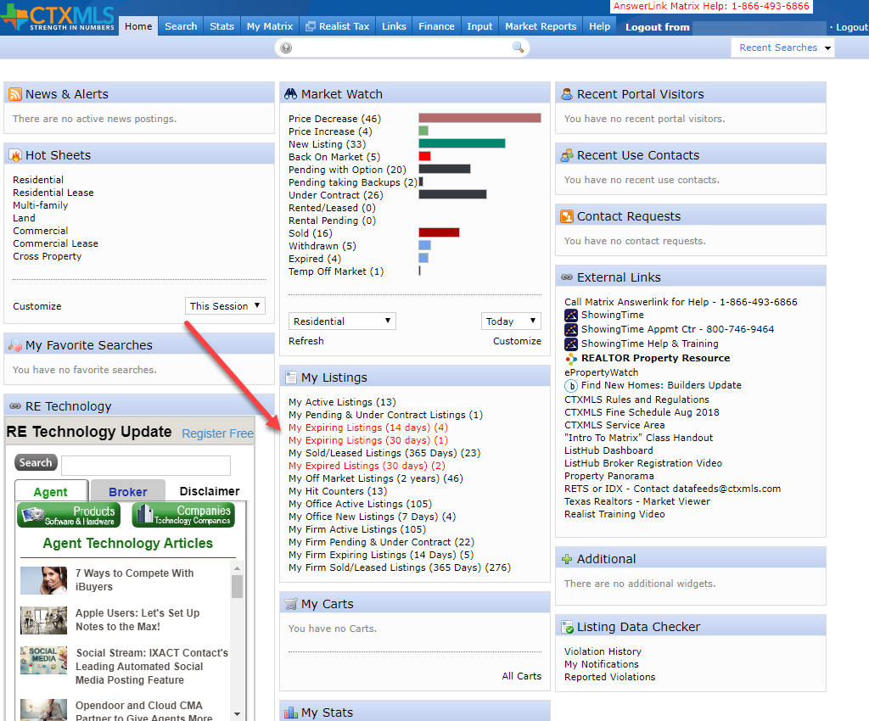
Incorrect Status:
Matrix shows you before they expire

Slide 65

Report IT
Click the Yellow Caution icon to send a manual Report IT on a listing.
Leave a detailed explanation of the suspected compliance issue and LDC Specialist shall investigate and render a decision if it warrants any further action.

Slide 66
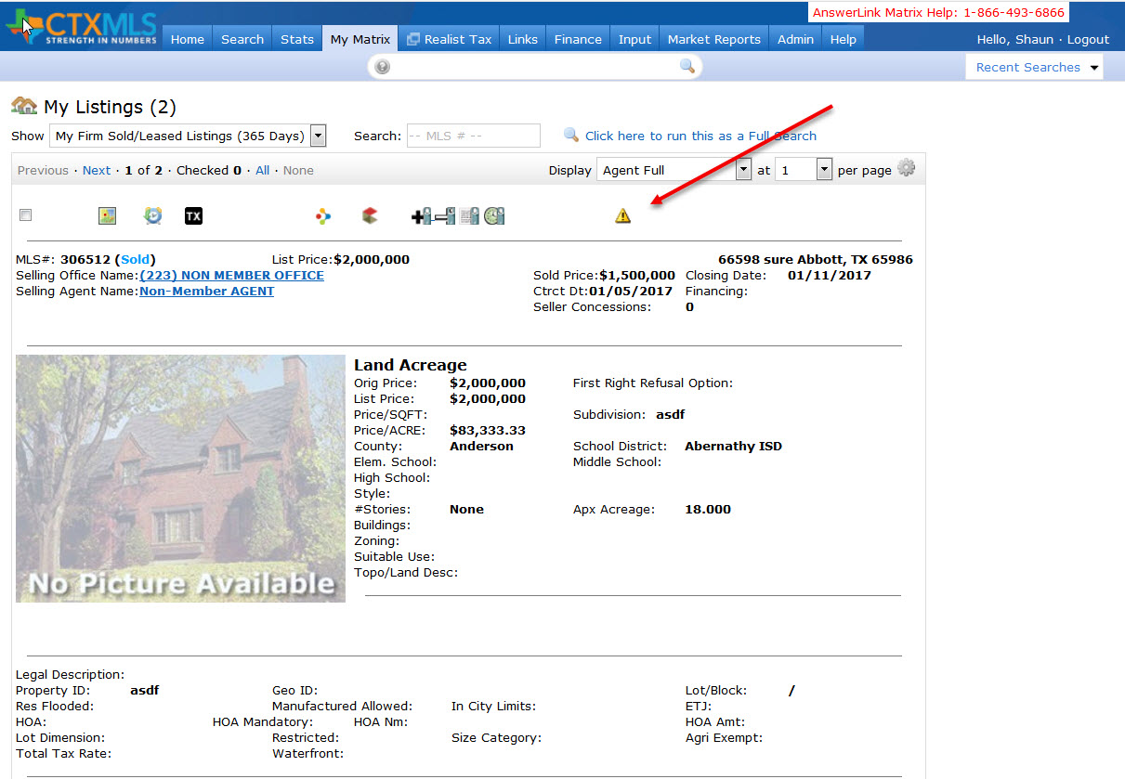
Report IT cont.

Slide 67
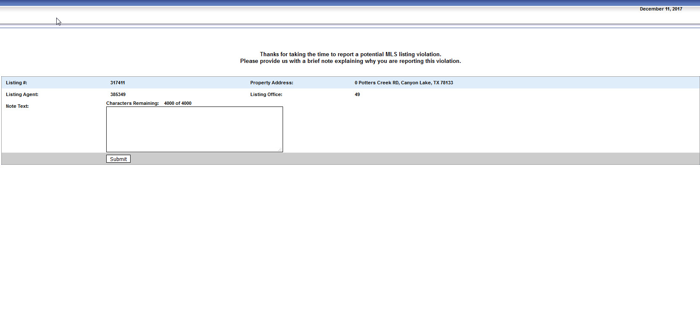
Report IT cont.
Notes:
Enter a short description of the compliance issue
All Report It’s are sent anonymously

Slide 68
Compliance Workflow
  Minor Offence:
    1st Warning – If you correct the listing no further action.
    2nd Warning – After 72 Hours a 2nd warning is sent to correct the listing.
    $100 Fine – 72 Hours after the 2nd warning it’s an automatic fine if not corrected.

Slide 69

Compliance Workflow cont.
Serious Offence:
  No warnings
  Automatic $100 Fine
  Allowing a listing to expire without changing the status to Sold
  Branded Photos
  Duplicating listings within the same property type

Slide 70
Compliance Workflow cont.
Egregious Offense:
  No Warning
  Automatic $1000 fine
  Sharing Password or Login
  Failure to provide Listing Agreement within 48 of request
  Failure to correct any of the mentioned compliance issues

Slide 71
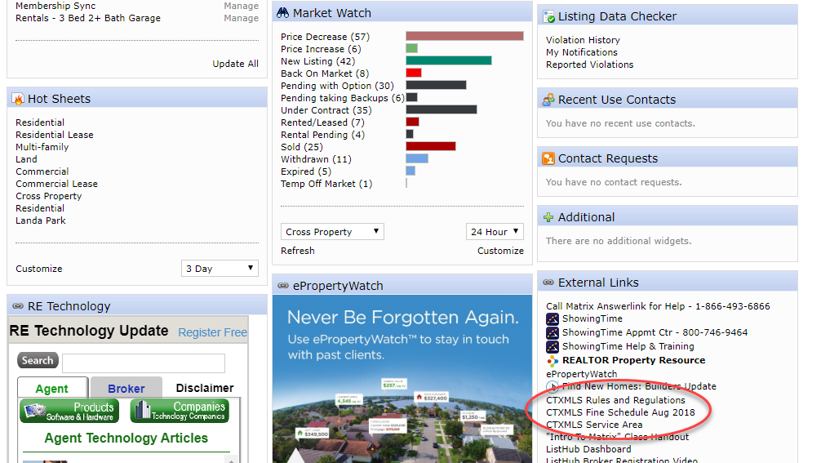
Notes:
Listings Rules, Fine Schedule, and coverage area can me found on the home page under External Links

Slide 72
Matrix

Slide 73
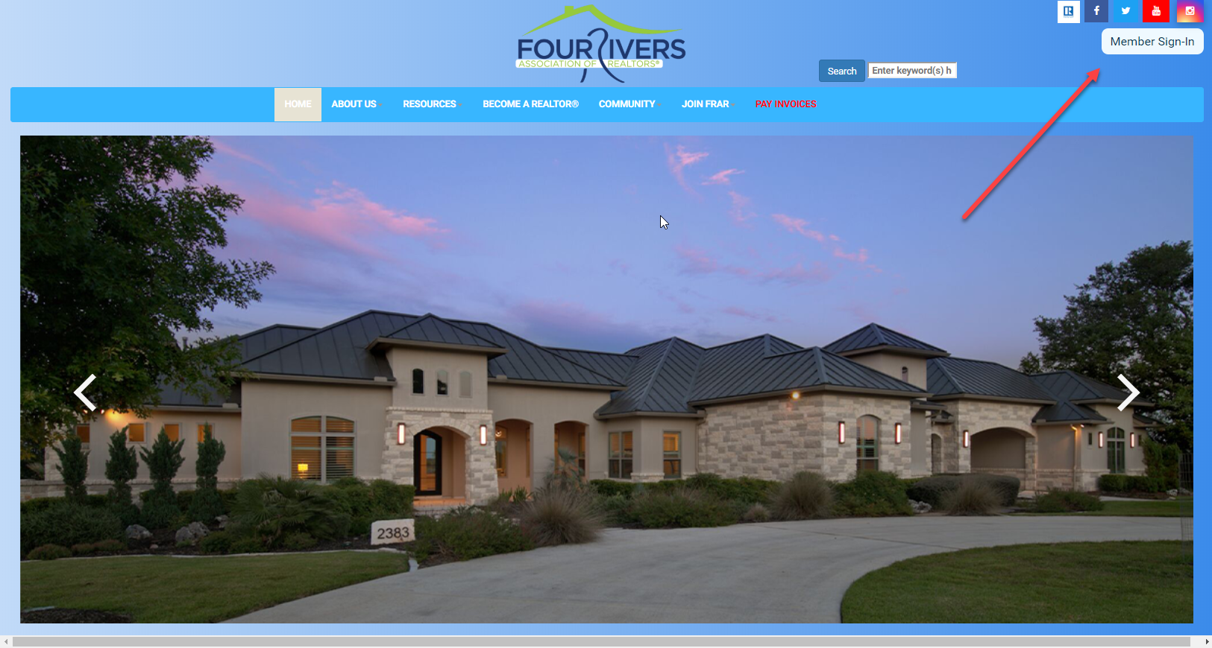
Matrix Cont.
Access via Fourriversrealtors.com from your Member Dashboard

Slide 74


Slide 75

Click CTXMLS button on your member dashboard to access Matrix

Slide 76
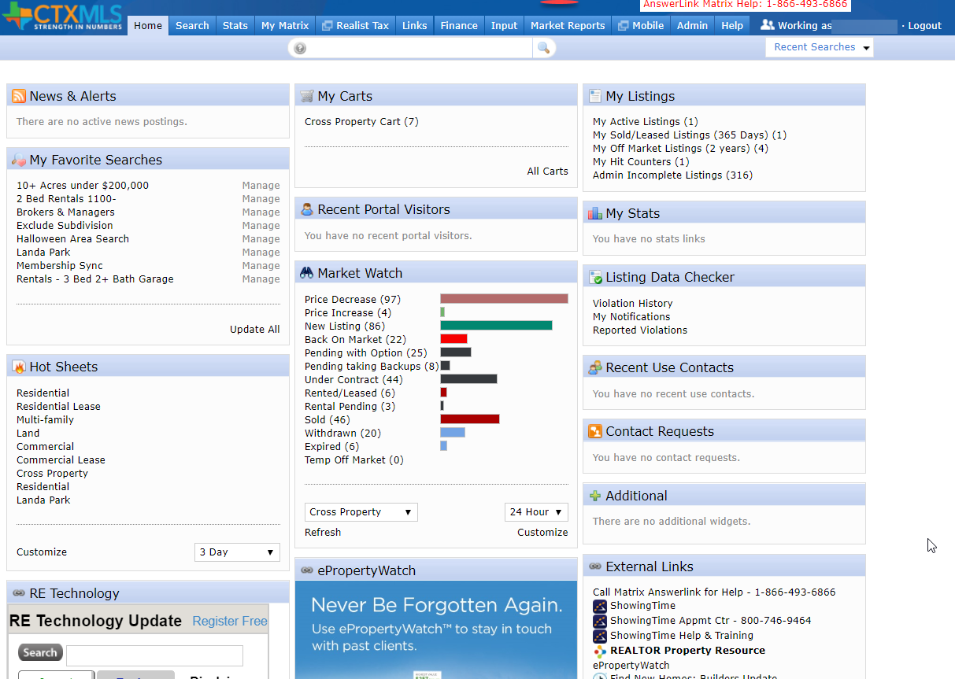
Matrix Home Page

Slide 77
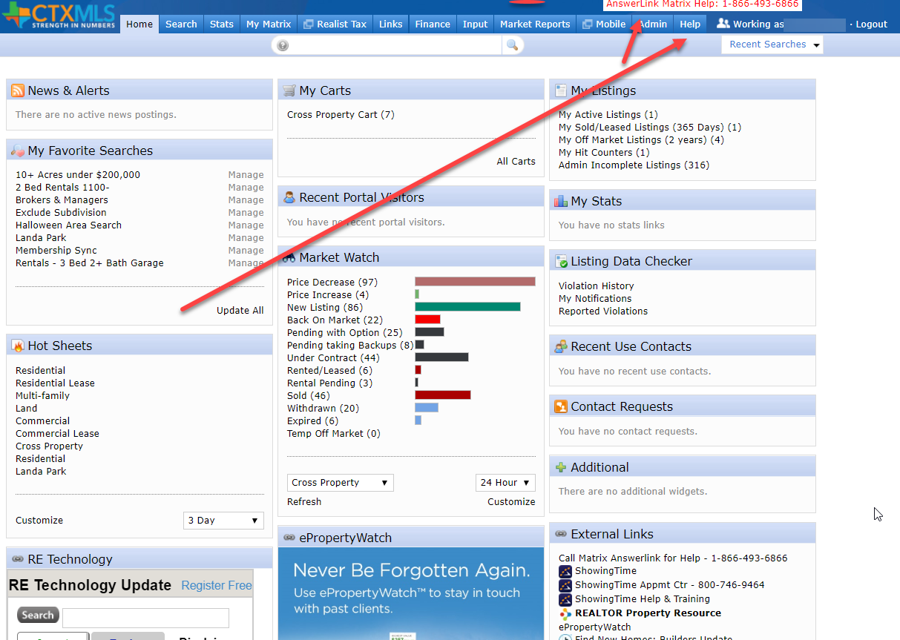
Help found under Help Tab or Answerlink
Notes:
Help can be found under the Help Tab or Four Rivers Staff or by calling Answerlink. NOTE: Answerlink is best as last resort or after hours.

Slide 78
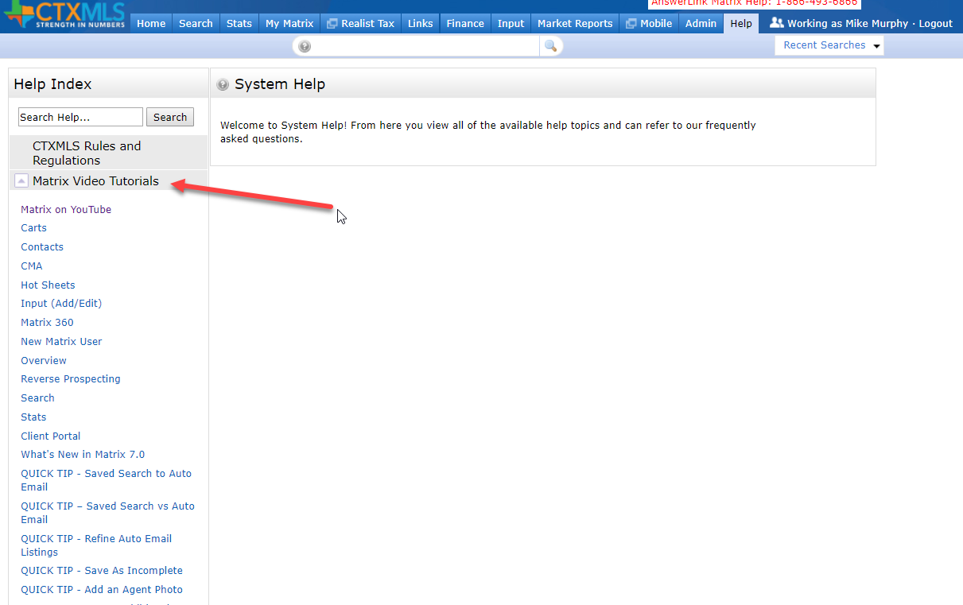
Video Tutorials found under Help Tab

Slide 79
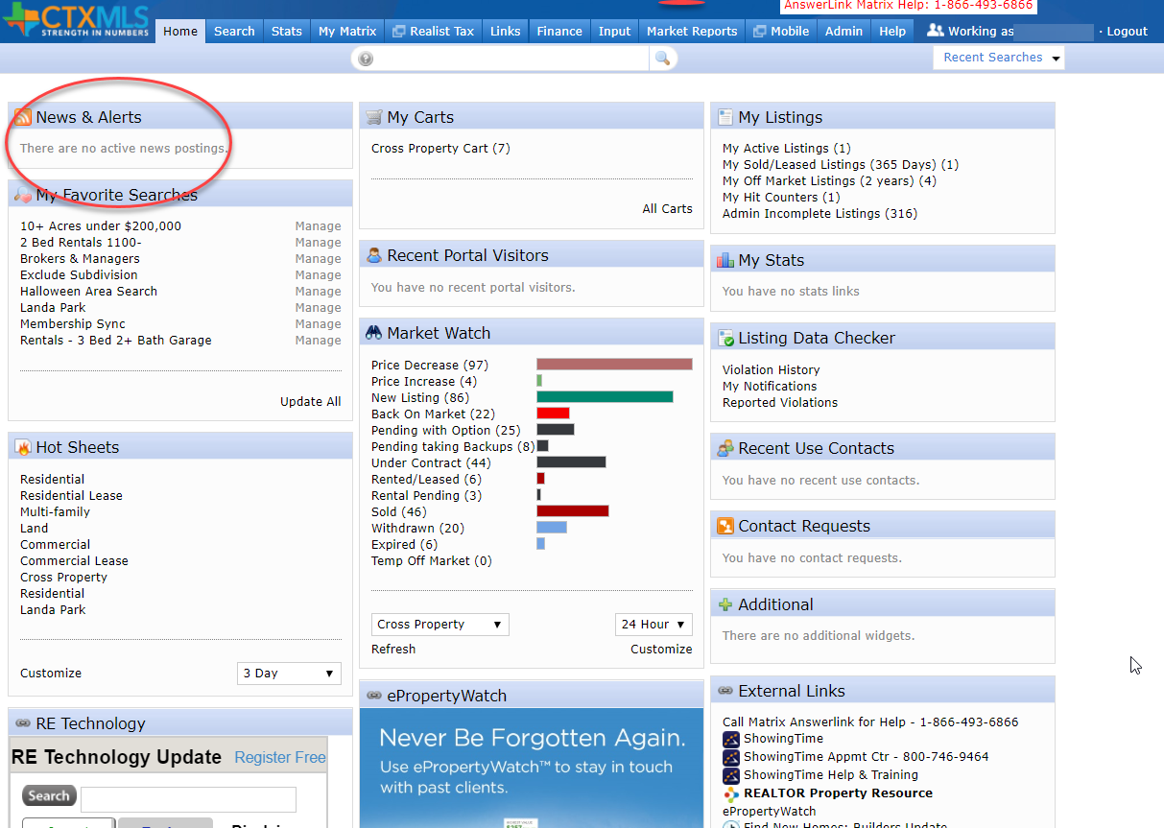

News & Alerts

Slide 80

Learning Center
On Members Home Page

Slide 81
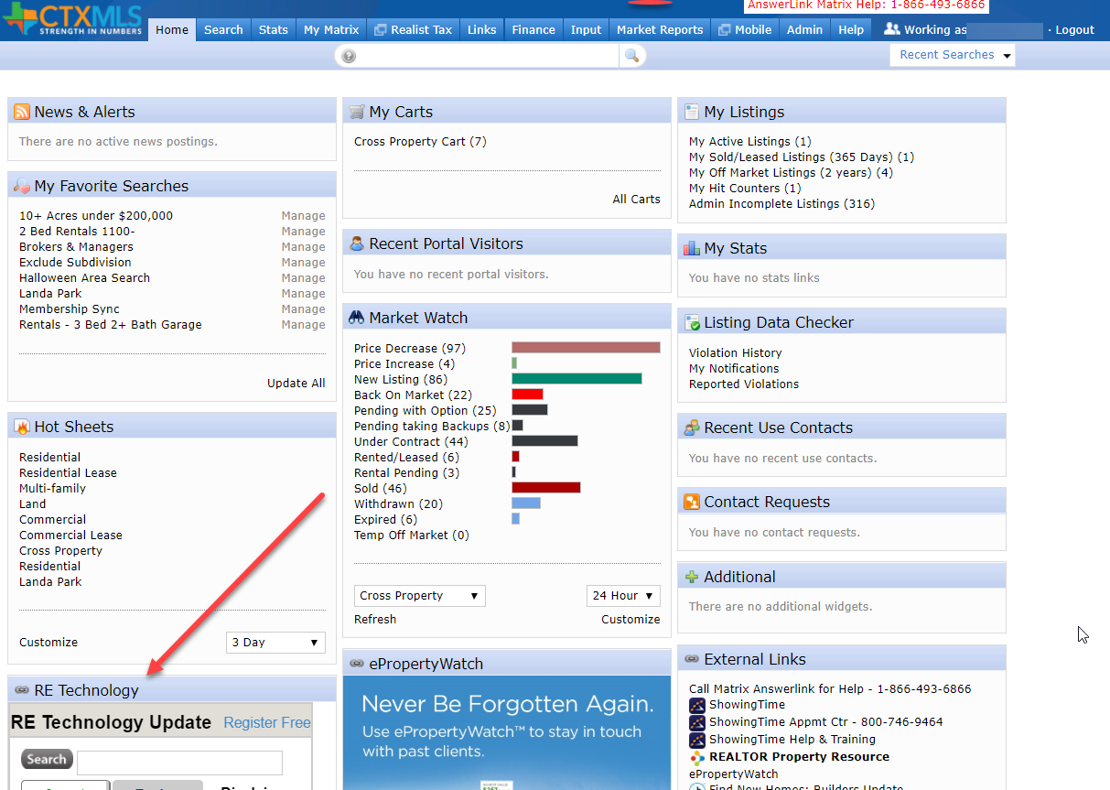
RE Technology
Industry News & Updates

Slide 82

RE Technology cont.

Slide 83


E Property Watch

Slide 84
E Property Watch cont.
This is a web and email service that brands your contact info and sends market and neighborhood updates to your clients
Electronic version of branded notepads and calendars
Keeps clients informed on home sales in their neighborhood

Slide 85
Did you know You can Farm using Public Records Search in Matrix?
No need to search in a separate Realist platform
Farm Neighborhoods directly in Matrix
Print Mailing labels

Slide 86
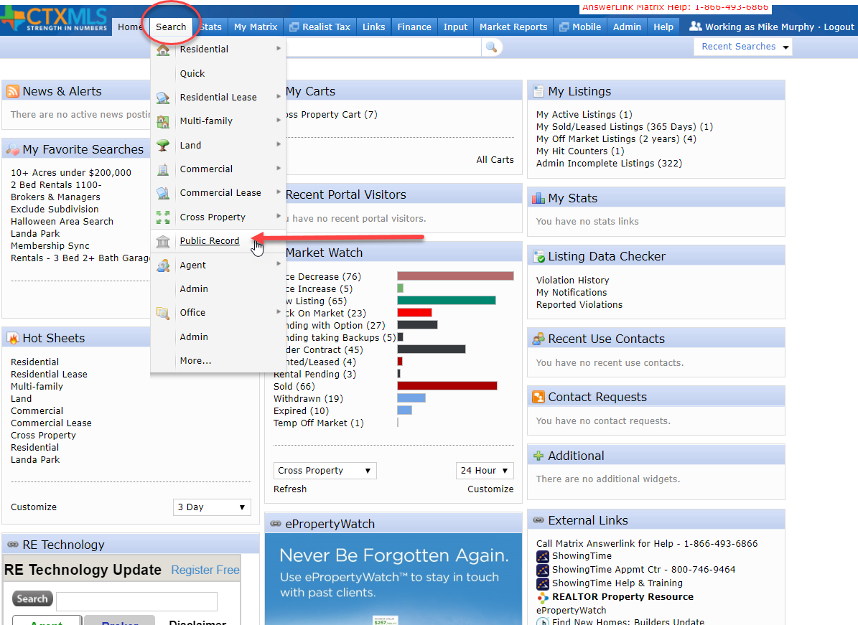
Public Records Search in Matrix cont.
Notes:
Click Search > Public Record

Slide 87
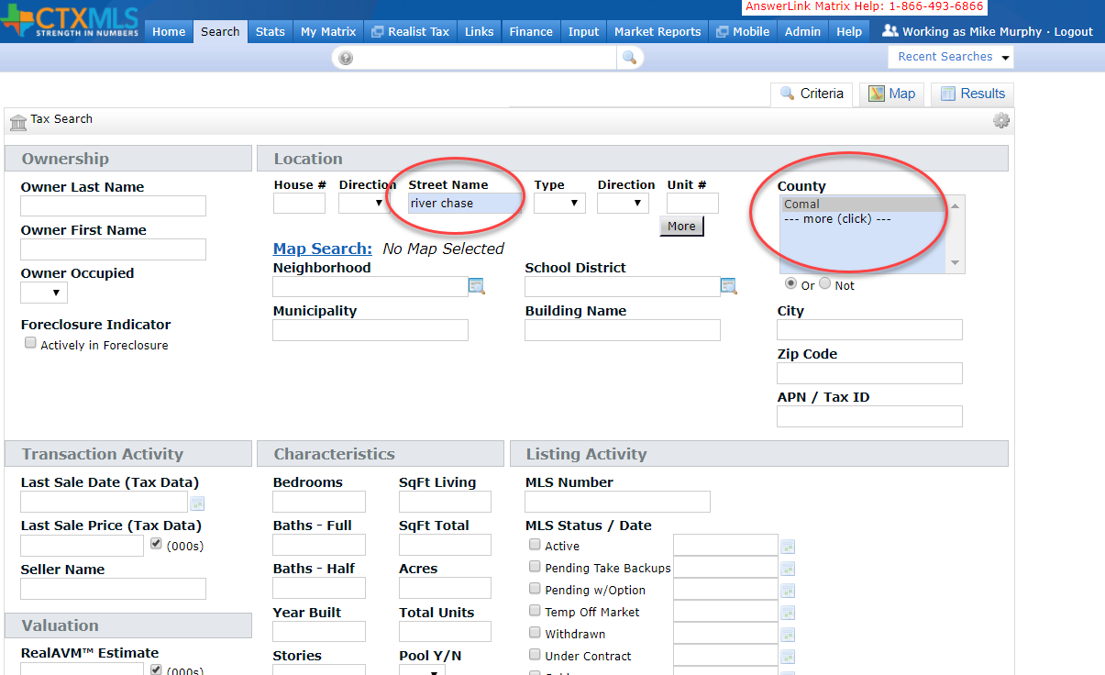
Public Records Search in Matrix cont.
Notes:
Street Name – River Chase
County – Comal
Click Results

Slide 88
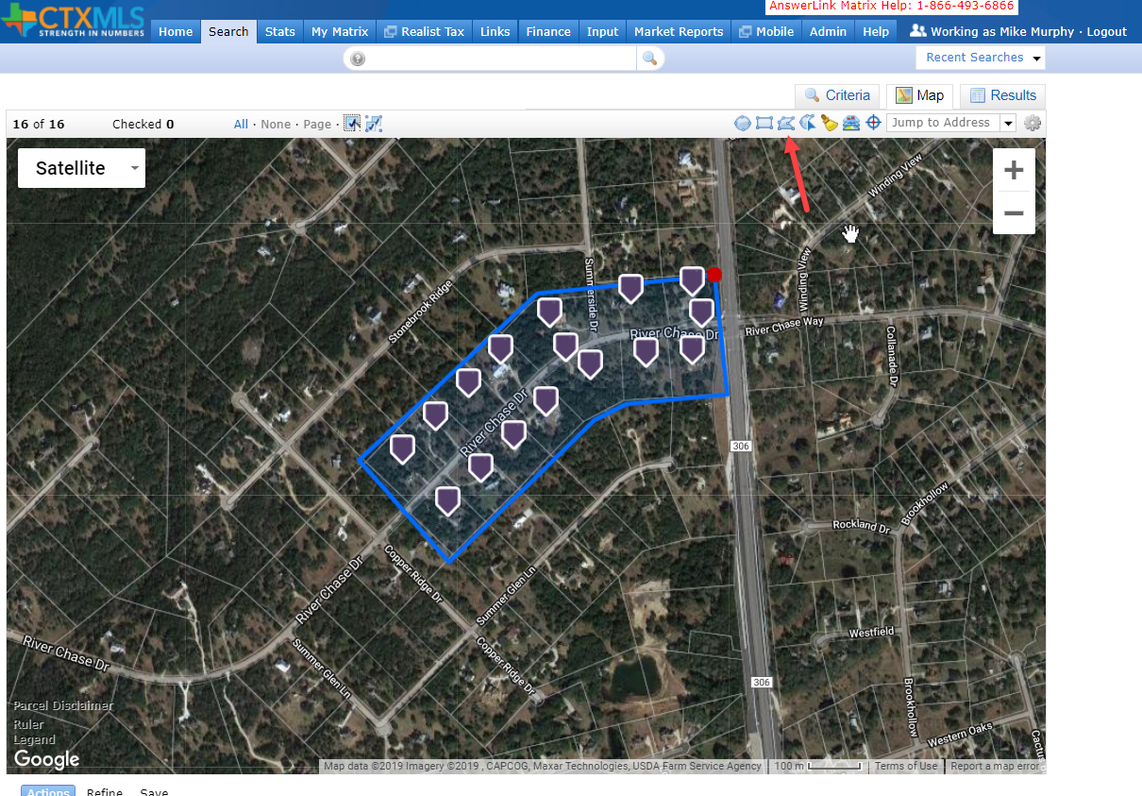
Public Records Search in Matrix cont.
Notes:
On the results, click Polygon icon to draw a polygon
Trace Neighborhood
Be sure to click on start point to close the polygon
Click Results

Slide 89
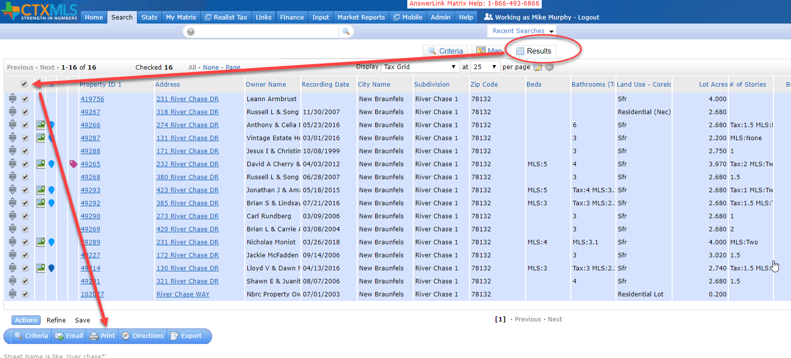
Public Records Search in Matrix cont.
Notes:
Click Results tab
Select the check box above results to select all results
Clcik the Print button on the bottom

Slide 90
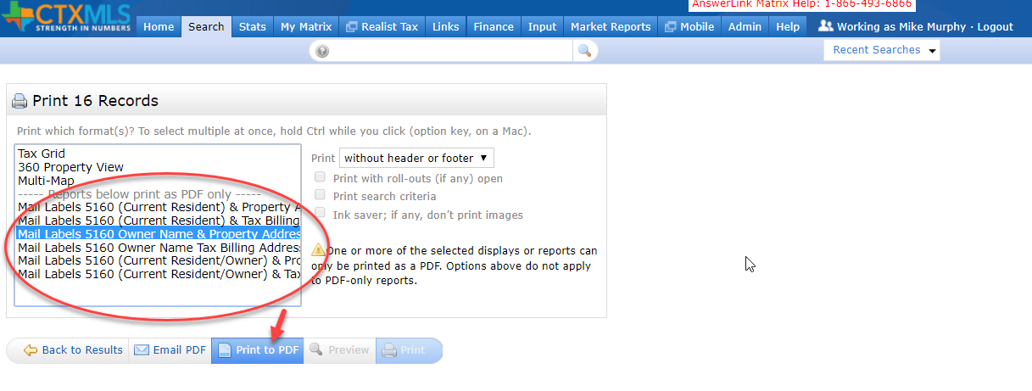
Public Records Search in Matrix cont.
Notes:
Select one of the Mail Label options
Click Print to PDF
Then print your mailing labels

Slide 91
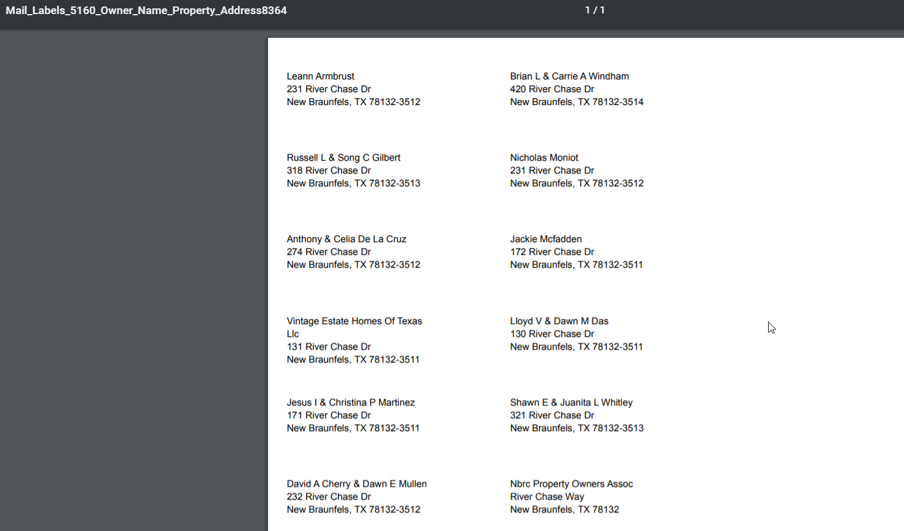
Public Records Search in Matrix cont.

Slide 92
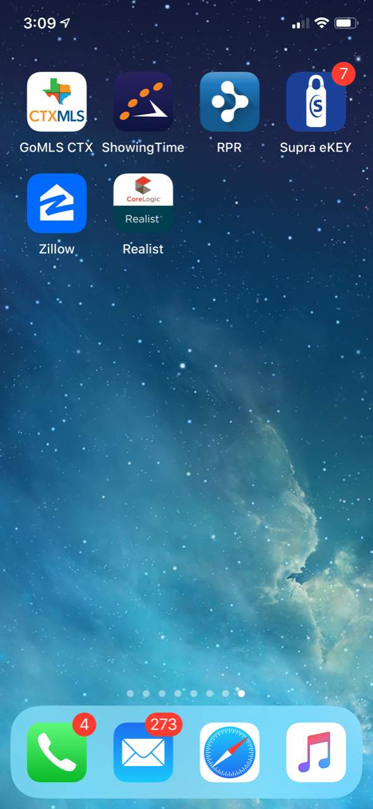
Mobile Apps

Slide 93
Free Mobile Apps
CTXMLS – GoMLS (Matrix Mobile)
ShowingTime
RPR – NAR National searches
Supra – Lockbox
Zillow

Slide 94
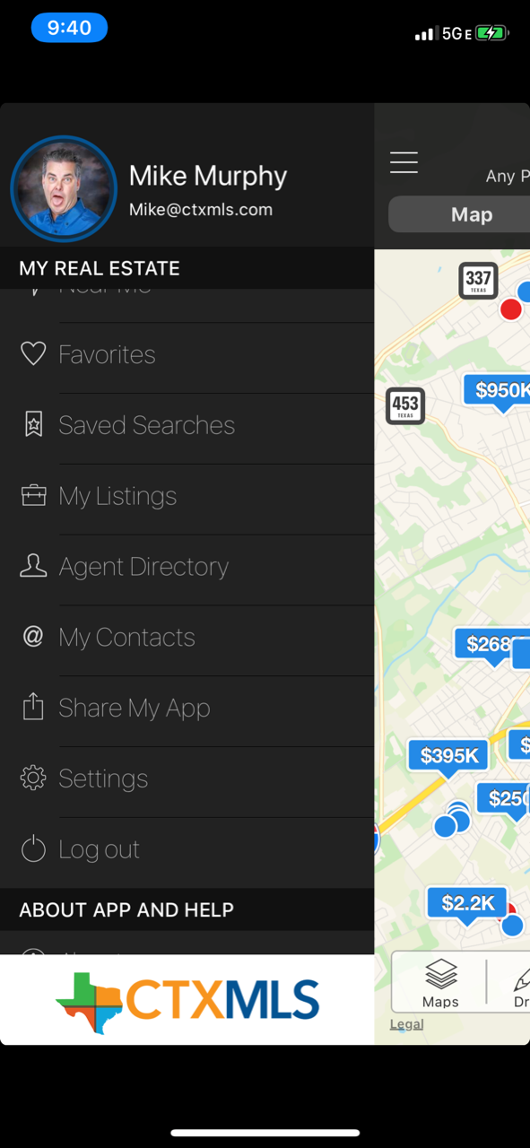
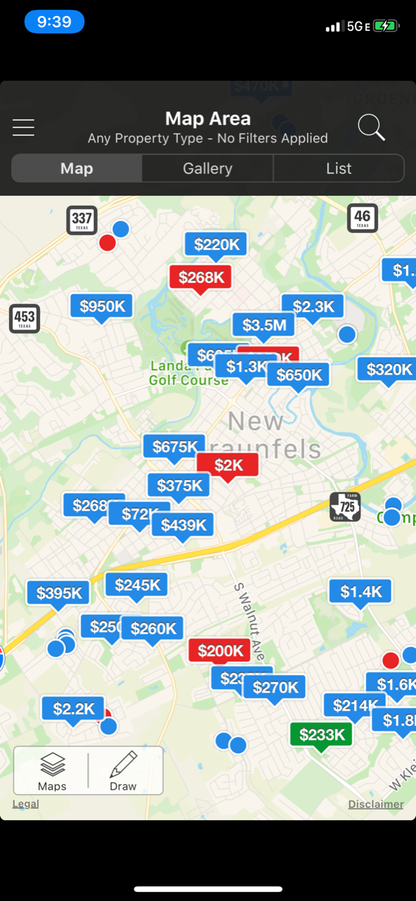
App Store search ctxmls
GoMLS: CTxMLS
Matrix Listings
Matrix Contacts
Branded with your info
Can be shared with clients
Agent sees active, sold, All
Clients only see Active List

Slide 95
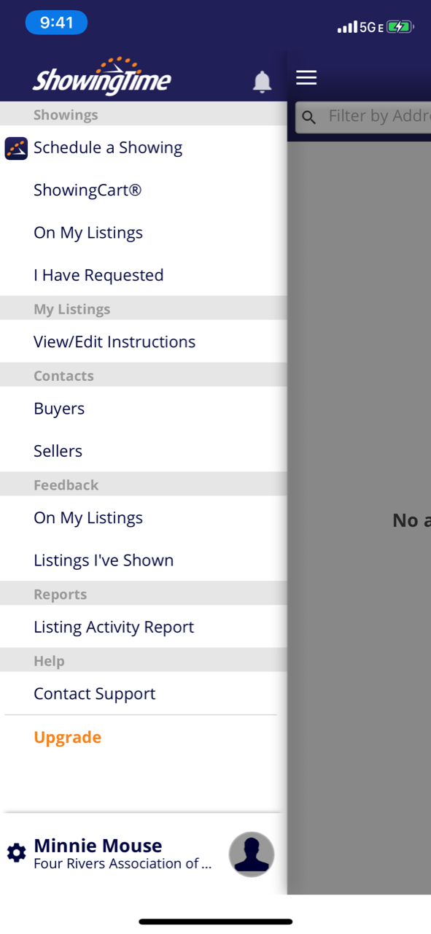
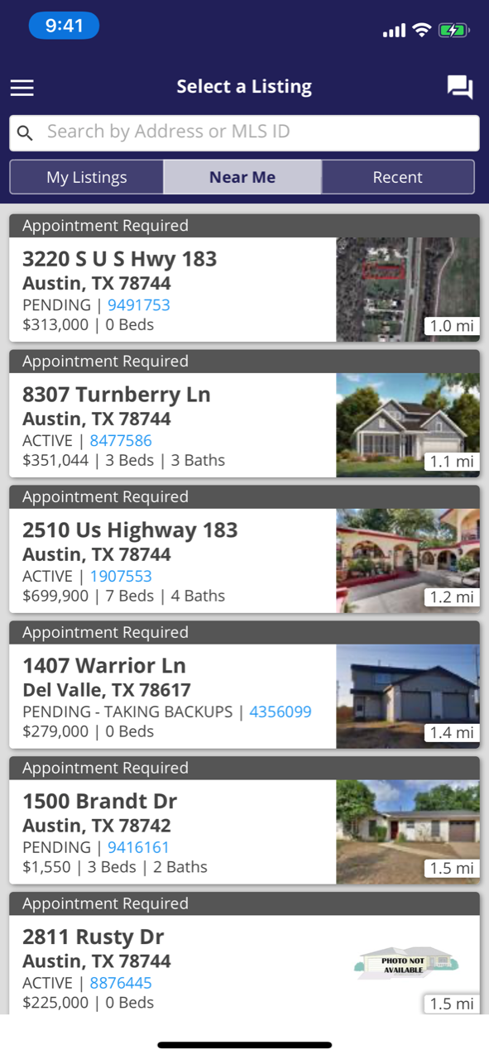
ShowingTime
Schedule Showings
Receive notifications
Text or Email
Chat direct with List Agent
Running behind
Delay Appmts 15 minutes

Slide 96
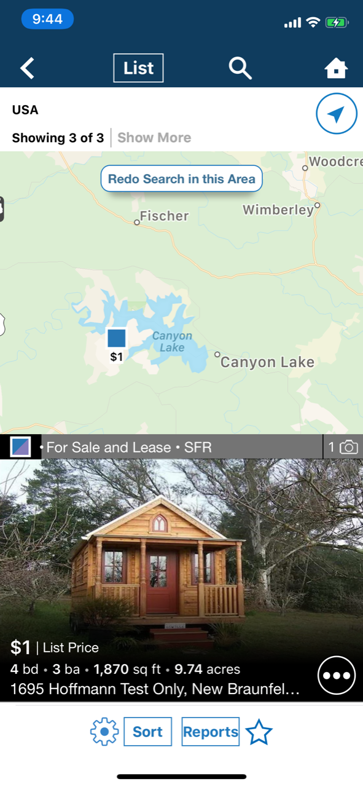

RPR (REALTORS® Property Resource )
Nation Search All MLS’
Nice Reports
Nice Display
Easy to use
Agent Only App
Free with NAR Membership

Slide 97


Slide 98

Supra
Bluetooth to open lockbox
Chat
Flashlight
ALERT – Will call contact emergency alert.
FRAR CoOp with CTXMLS
San Antonio and Austin

Slide 99
Zillow
Easy Search
Household name clients use this
Nice UI
Adding Search by Brand or appliance, etc
Search Viking stove
Adding 360 video

Slide 100


Zillow Cont.

Slide 101
We invite you to stay for
Matrix Training
following this Orientation.

Slide 102
I AM A REALTOR®
I Pledge Myself To strive to be honorable and to abide by the Golden Rule; To strive to serve well my community, and through it, my country; To abide by the REALTORS'® Code of Ethics and to strive to conform my conduct to its aspirational ideals; To act honestly in all real estate dealings; To protect the individual right of real estate ownership and to widen the opportunity to enjoy it; To seek better to represent my clients by building my knowledge and competence

Slide 103


Slide 104

Thank you for joining us today!
You will receive an email with a brief survey to give
us feedback on this class and all the information
and links to this presentation.
Picture Time!

